Slide 1
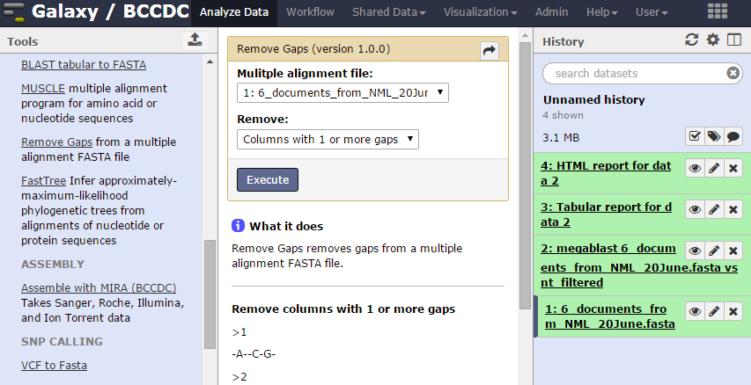
Building a Galaxy Tool
Benefits of the Galaxy way:
  Galaxy helps you get organized: Histories
  Experimental reproducibility: Record-keeping
  Tool Sharing, e.g. to support publication
Created by Damion Dooley, Hsiao Lab, BC Public Health Microbiology & Reference Laboratory,
BC Centre for Disease Control, https://github.com/Public-Health-Bioinformatics

Slide 2
Galaxy Intro
Tool web form that a user can fill in and submit.
Results put into a user's history as a dataset that can be viewed, downloaded or used as part of a larger workflow.
List of available tools
See: http://salk.bccdc.med.ubc.ca/galaxylab

Slide 3
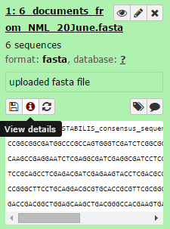
Galaxy Datasets
History tab's dataset items are tool inputs and outputs.
Galaxy's data type system specifies structured data formats (fasta, sam, bam, etc.), including ones that involve several files.
Galaxy guesses the type of file a user has uploaded.
You can control what (standard) type of input data your tool takes.

Slide 4
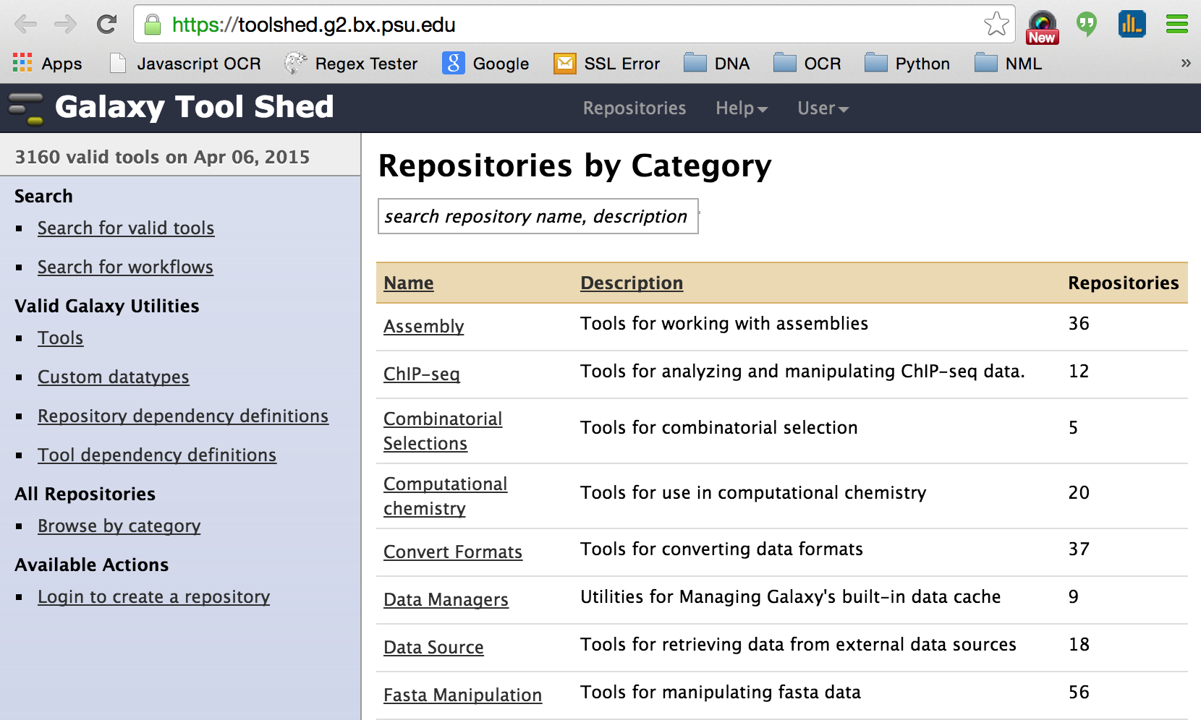
Galaxy Toolshed
Basic Galaxy tools:http://salk.bccdc.med.ubc.ca/galaxylab
Main Library: https://toolshed.g2.bx.psu.edu/
BCCDC playground: http://salk.bccdc.med.ubc.ca/toolshed

Slide 5
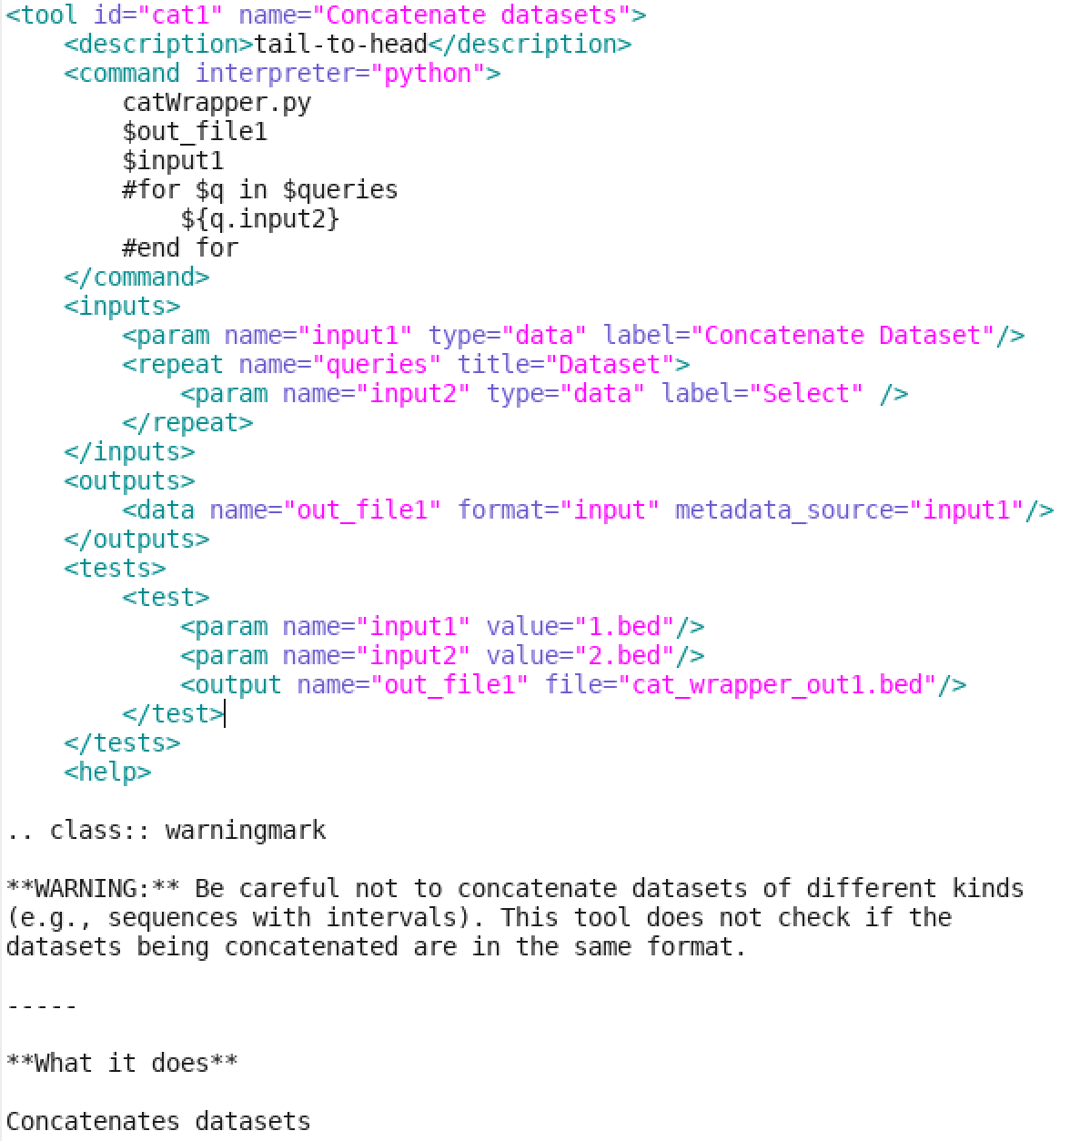
Tool Development Process
Stages
Develop command line script
Craft XML “tool definition file”
View & run form in Galaxy
Make and pass tests
Add documentation
Share

Slide 6
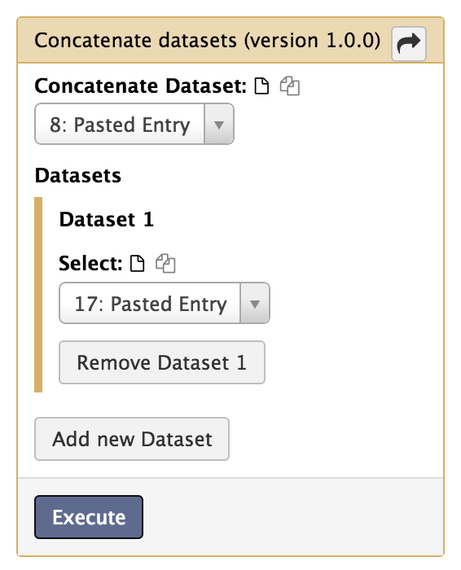
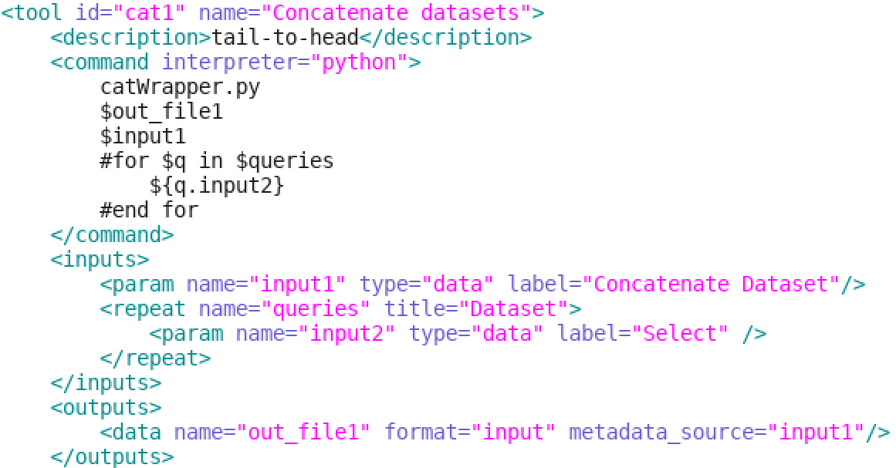
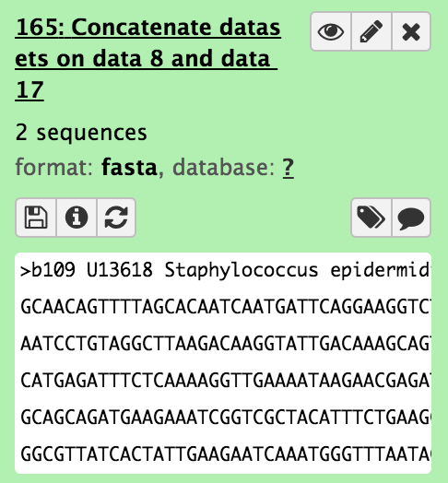
Anatomy of a tool
An XML file controls form display, field validation and app execution. Tags specify the command to be run, fields for selecting input file(s), etc.
Examples are in the tools/ folder of a Galaxy installation.

Slide 7
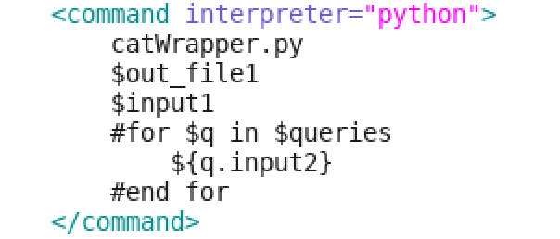
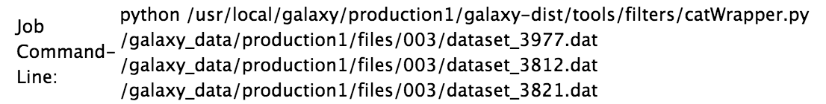
<command interpreter=”...”>
The command is any linux shell command, or python, java, or other executable (that Galaxy knows of).
It runs with the Galaxy user's permissions.
Galaxy sets the tool's exact input and output file paths.
Command tag allows Cheetah expressions.

Slide 8
<inputs> <param type=”data”>
Provides a file selector of one or more input files from current history.
You can constrain this to files of a particular data type.
Add ' multiple=”true” ' : allows selection of more than one file. These will be passed as a comma-delimited list.

Slide 9
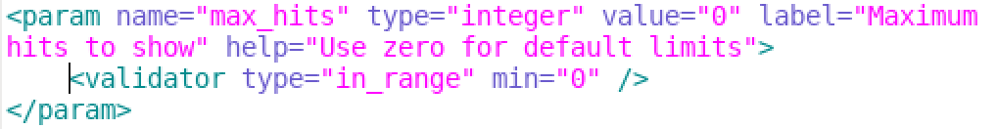
<inputs> <param type=”...”>
Each form field entry can be passed as a string value to a command line call parameter.
“integer” : This shows some range validation on the input.
“float” : Input accepts decimal numbers
“boolean” :

Slide 10
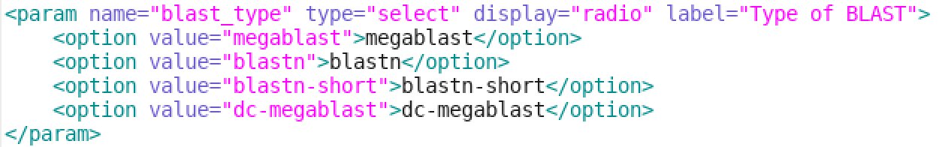
<inputs> <param type=”...”>
“select” : drop down list or radio/checkboxes
“text” : provides text input field.
“data_table” : Filter and display rows / columns from a Galaxy-registered tab-delimited table
... and others. See:
https://wiki.galaxyproject.org/Admin/Tools/ToolConfigSyntax

Slide 11
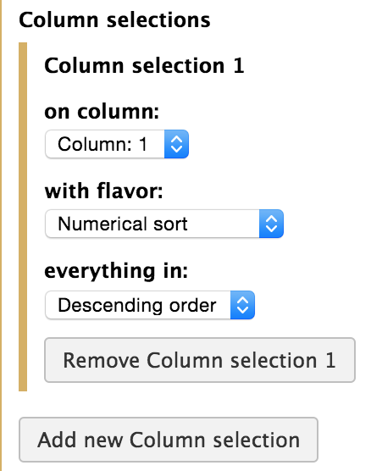
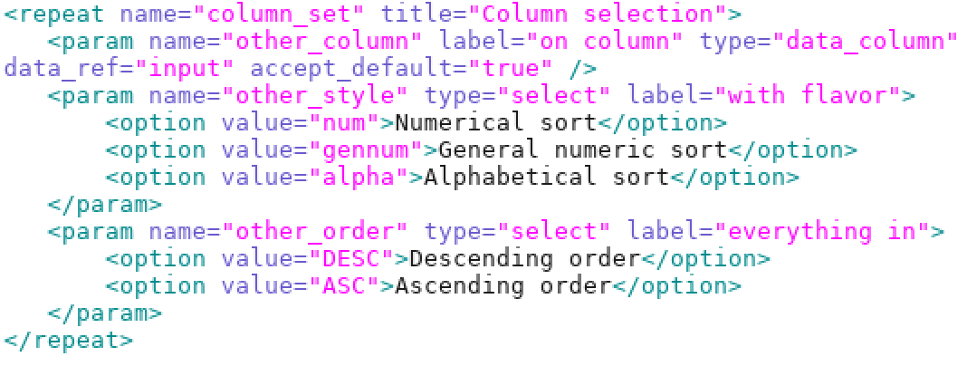
<inputs> <repeat ...>
Use a <repeat> to collect associated parameter inputs.
Example from Galaxy tools/sorter.xml file.

Slide 12
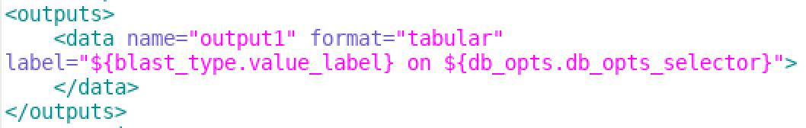
<outputs><data name=”...”>
The <outputs> section has one or more <data ...> tag output file specifications. For each <data> tag Galaxy will set up a new dataset file path to output your app's data to.
format=”...” : Contains one of Galaxy's data types listed in admin tab > Administrator > Server > View data types registry.
The “label” shows up as the dataset name of a history record.

Slide 13

Error handling
Apps generate exit code=0 for normal operation; higher numbers are error or warning codes. How Galaxy should interpret them is up to you; normally 0 means “green” ok; anything else triggers a red “failed” state.
The <stdio> tag holds any codes you want to upgrade or downgrade the error state for.
<stdio><exit_code range=”1:” level=”fatal”/></stdio>
Robot from Lost in Space (1965)
<stdio>
<exit_code range="2" level="fatal" description="Out of Memory" />
<exit_code range="3:5" level="warning" description="Low disk space" />
<exit_code range="6:" level="fatal" description="Bad input dataset" />
<!-- If the return code has not been set propery check stderr too -->
<regex match="Error:" />
<regex match="Exception:" />
</stdio>

Slide 14
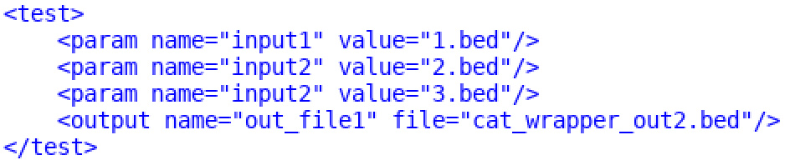
Tests
Not required for local use, but for a shared tool, tests are expected.
Specify input parameters by name and value as they would be entered in form.
The input and output files are specified in tool's “test-data” folder.
Normally time consuming to test in Galaxy directly, so we use “planemo”

Slide 15
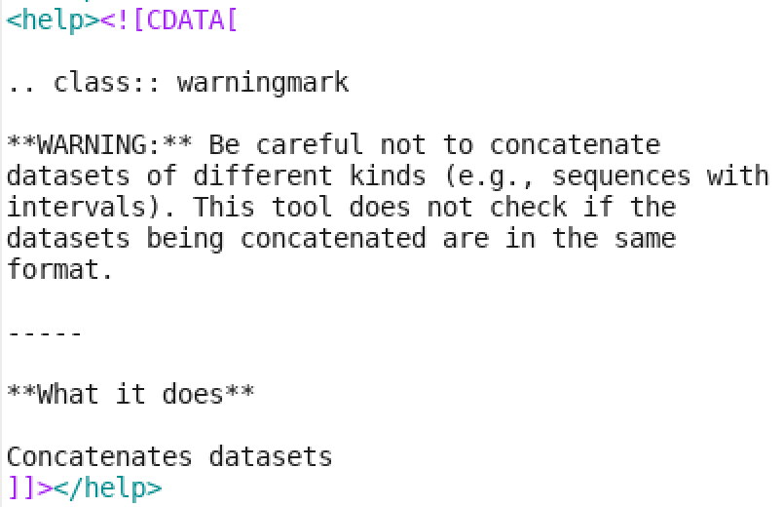
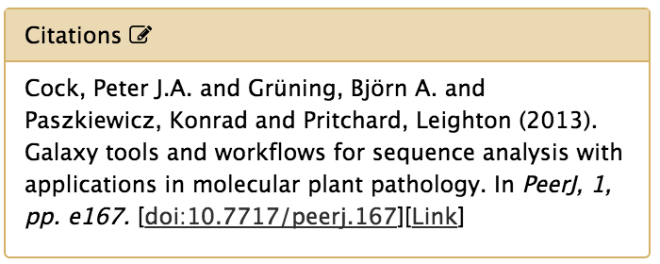
Help Info
“Free” text can only be inserted at form bottom below the Execute button. It uses reStructuredText markdown format:
http://docutils.sourceforge.net/docs/user/rst/quickref.html
Add a references section if your app uses 3rd party software or if it is based on your own paper. This can simply be a help section **References** header and text. It can also include an automated lookup:
<citations>
<citation type="doi">10.7717/peerj.167</citation>
</citations>

Slide 16

Ready?
Self-Operating Napkin
(Copyright © Rube Goldberg™
& © of Rube Goldberg, Inc.)

Slide 17
Get Started on your Galaxy Server
We use the “Planemo” python app to get started with tool development. It can set up a new tool project with a template, validate tool's XML, run Galaxy tests, and launch a tool in a trimmed-down Galaxy.
Use a terminal to “ssh -X ...” to enable X-windows apps. (“ssh -Y ...” for Mac users).
Navigate to the Galaxy installation's tools/TESTING/ subfolder.
> cd /usr/local/galaxy/galaxytest/galaxy-dist/tools/TESTING/
Make a folder for your tool:
> mkdir randomish; cd randomish

Slide 18
Using Planemo
Try planemo out on a demo project template that has a few tool definition XML files in it (it works with a folder of them at a time):
> planemo project_init --template=demo
Now edit a tool XML file:
> gedit randomlines.xml &
OR start from scratch, with some info on your command line app:
> planemo tool_init --force --id '[your galaxy tool id]' \
--name '[name of your tool]' \
--requirement [some linux package dependency]@1.0-r68 \
--example_command '[your app] seq -a [file 1] > [file 2]' \
--example_input 2.fastq \
--example_output 2.fasta

Slide 19
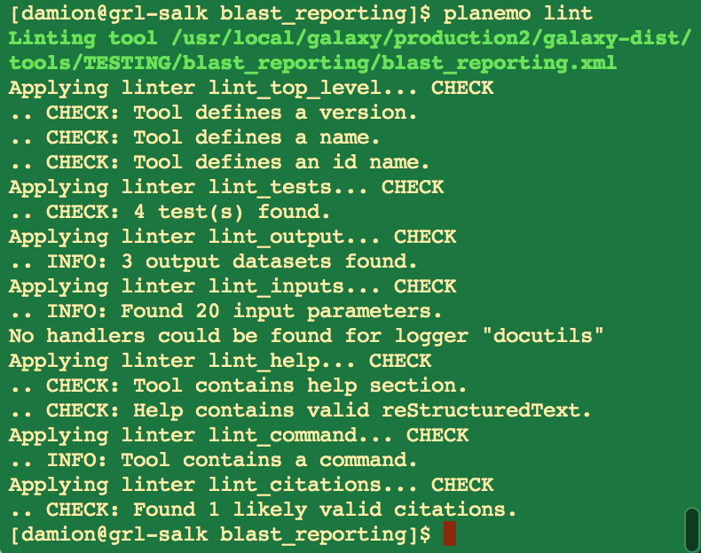
Using Planemo
See planemo validate XML:
> planemo lint
Have planemo generate test report:
> planemo test
... wait a while for the results.
Planemo uses the same tests that Galaxy does – the same input and output files.
Galaxy runs tests on tools that are shared on toolsheds.

Slide 20
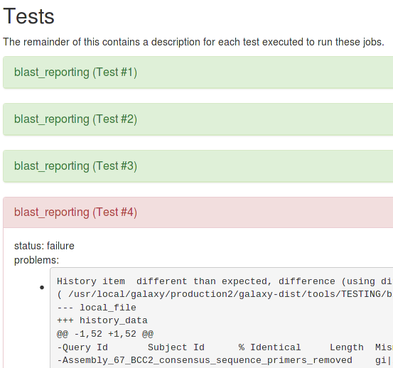
Using Planemo
Firefox will run via X11 on the server so you can view a planemo test report:
> firefox tool_test_output.html &

Slide 21
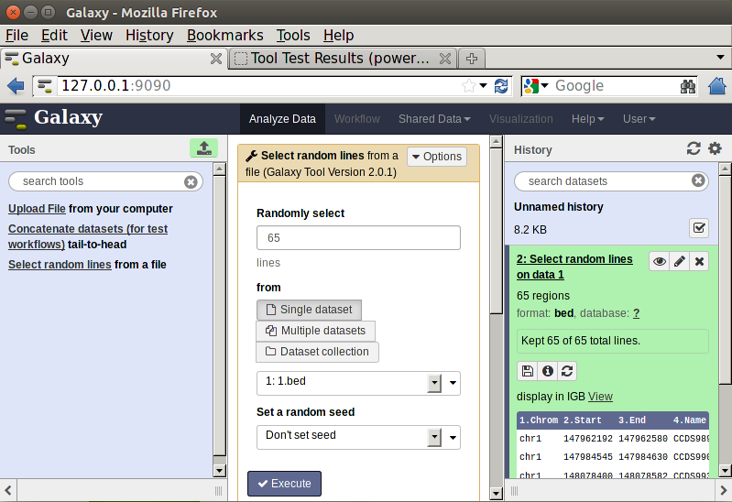
Using Planemo
You can play with your tool in Galaxy via planemo “serve” which serves the galaxy website at http://127.0.0.1:9090 ... after a while.
> planemo serve
(Ctrl-c cancels)
For a great intro to planemo's other features, see https://planemo.readthedocs.org/en/latest/writing_standalone.html

Slide 22
Testing Issues
Small Print: Planemo should report all nasty errors for you to remedy. If however, it fails to do so, or you don't have access to Planemo, and you are trying to install your tool into galaxy directly, then Galaxy will likely not load the tool into its menu system, or even re-start. For this reason tool development can't be easily or safely done on an active Galaxy server. You may find buried in Galaxy's web0.log or paster.log reference to the tool not loading. Startup issues are usually about a tool's malformed XML (incomplete tags, bad nesting, characters that XML sniffs its nose at) or sometimes script compilation issues. For <command> and <help> content this can be avoided by wrapping its text in the <![CDATA[ ... ]]> tag. In the event that this does not remedy the situation, understand that there is no warranty expressed or implied; however possible remedies may be obtained by the very friendly galaxy-dev@lists.galaxyproject.org listserv, or yours truly.

Slide 23
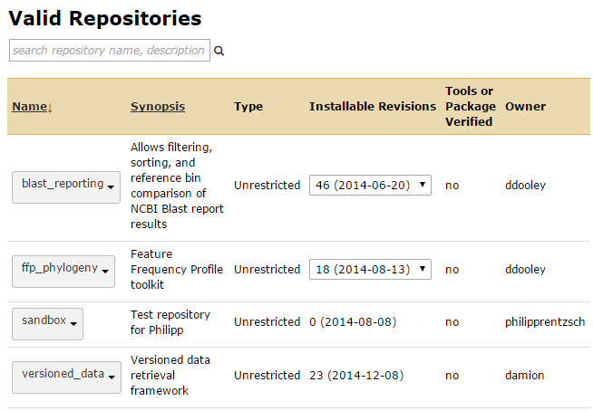
Sharing your Galaxy tool with the world
This involves uploading the tool files into a Galaxy "toolshed".
A Galaxy admin can select them for installation at their own location.

Slide 24
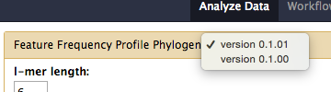
Galaxy Tool – Versioning
With a few tool versions installed on a Galaxy server, a user will have a choice of which to run.

Slide 25

Preparing a Toolshed Update
Every tool should have a version number at the top of its XML file:
<tool id=”blast_reporting” name=”BLAST Reporting” version=”1.0.5”>
Mask of Yul Brynner, Westworld (1973)
Uploads to main Galaxy toolshed should include a version number increment.
However, try to limit uploads to significant changes.
If version number stays the same: the upload becomes an update to the existing toolshed version. If a Galaxy admin downloads your changes they will be applied to their currently loaded tool (if same version). This may be a problem for experimental reproducibility

Slide 26
Preparing a Toolshed Update
Make a tar archive of the tool folder contents.
Select which files or subfolders to include or exclude in the archive. E.g. include all files except text editor backups, compiled python templates, and planemo output reports:
> tar -zcvf [tool name].tar.gz * --exclude "*~" --exclude "*.pyc"
--exclude "tool_test_output*" --exclude "*.gz"
Download to your local computer so that it can be uploaded to a Galaxy toolshed. The last “./” places the file in your current folder.
> scp [your user name]@[your server name]:
/usr/local/galaxy/galaxytest/galaxy-dist/tools/TESTING/[folder]/
[tool name].tar.gz ./

Slide 27
Links
The Galaxy developer's email list is a great place to get help
http://dev.list.galaxyproject.org
Galaxy Documentation
https://wiki.galaxyproject.org/Admin/Tools/WritingTests
https://wiki.galaxyproject.org/Admin/Tools/AddToolTutorial
https://wiki.galaxyproject.org/Tools/BestPracticeshttps://wiki.galaxyproject.org/ToolShed/PublishTool
The Galaxy tool parameter syntax (not complete)
https://wiki.galaxyproject.org/Admin/Tools/ToolConfigSyntax
Planemo Tool tester and Tutorial
﻿﻿http://planemo.readthedocs.org
Cheeta expression language
http://cheetahtemplate.org/learn.html

